Slide 1
Co-Teaching
Christina Wilson
and
Crystal Vogt

Slide 2
Training
Week-long training at ESD
Kathleen Kryza
Shared many ideas and gave time to plan

Slide 3
Inclusion
Special education students have an opportunity to experience the general education curriculum.

Slide 4
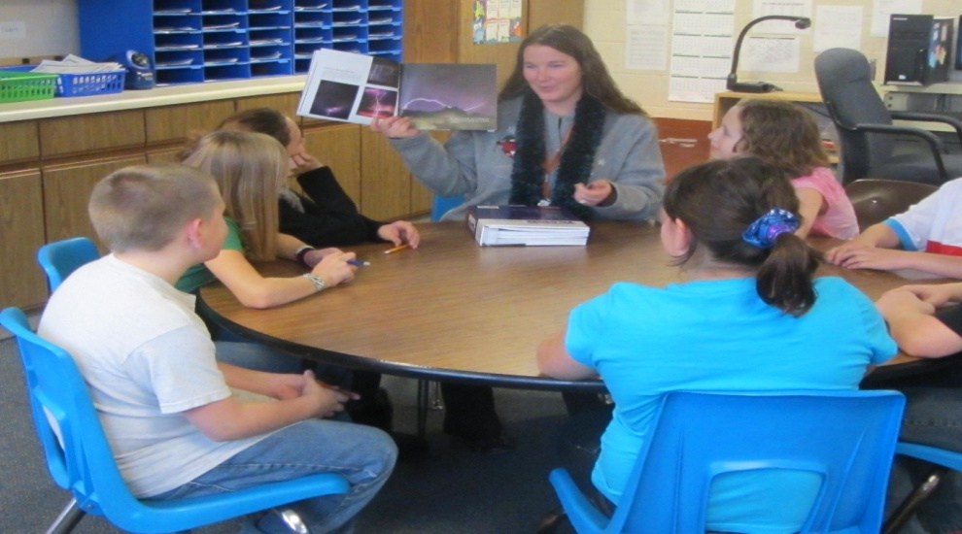
Station A
Mrs. Wilson
Comprehension Toolkit
Reading comprehension and reading strategies

Slide 5
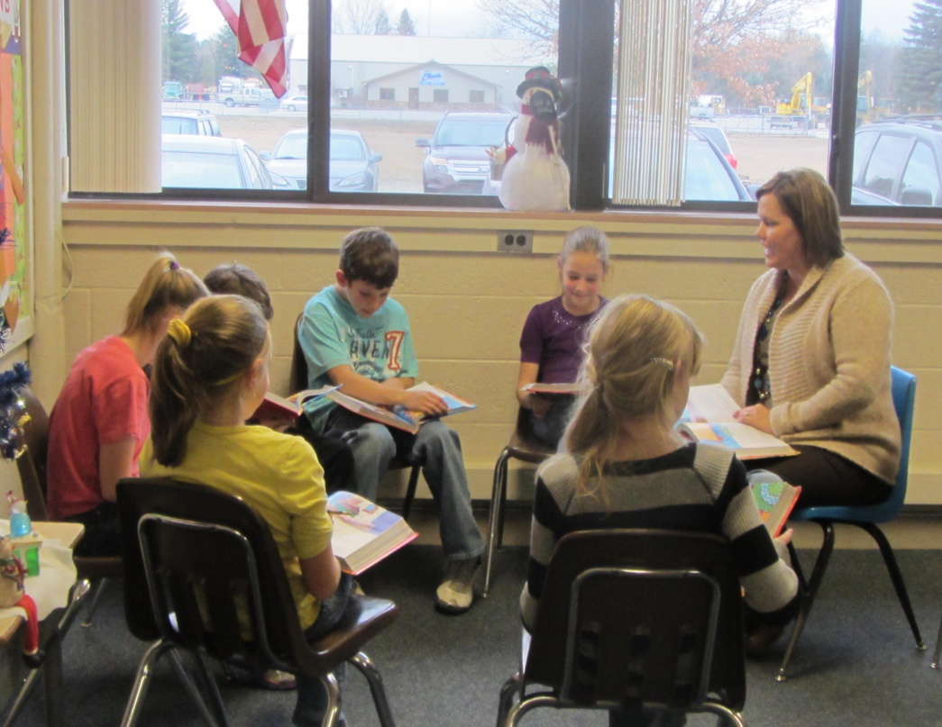
Station B
Mrs. Vogt
Fluency
Specific skills

Slide 6
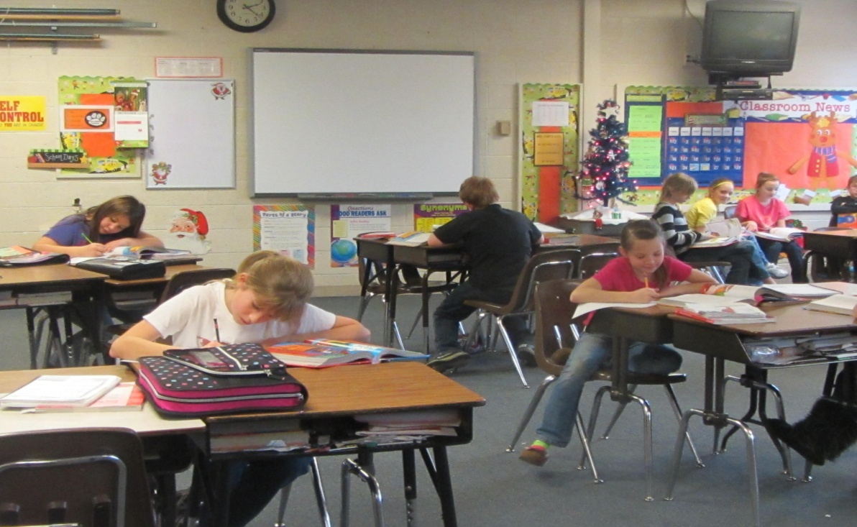
Station C
Independent work
Vocabulary activities

Slide 7
How do you feel
about co-teaching
and stations?

Slide 8
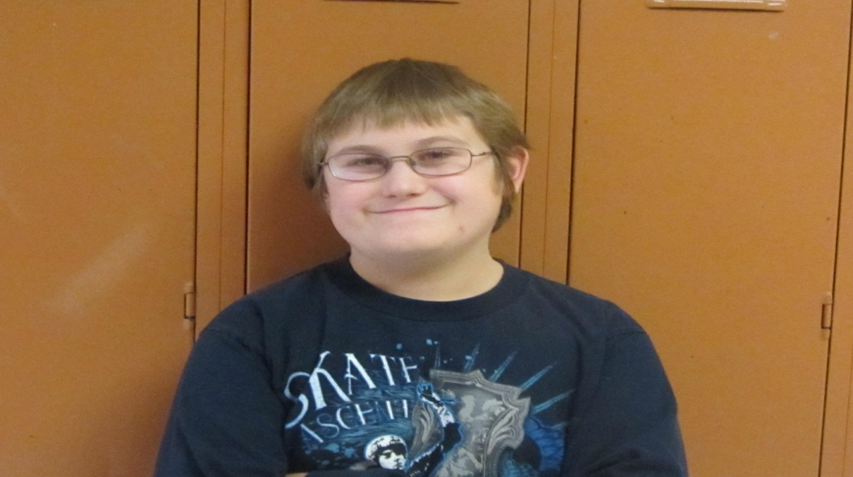
Andrew
I like co-teaching because I get to spend time with my two favorite teachers and hear what they are teaching us in two different ways.

Slide 9
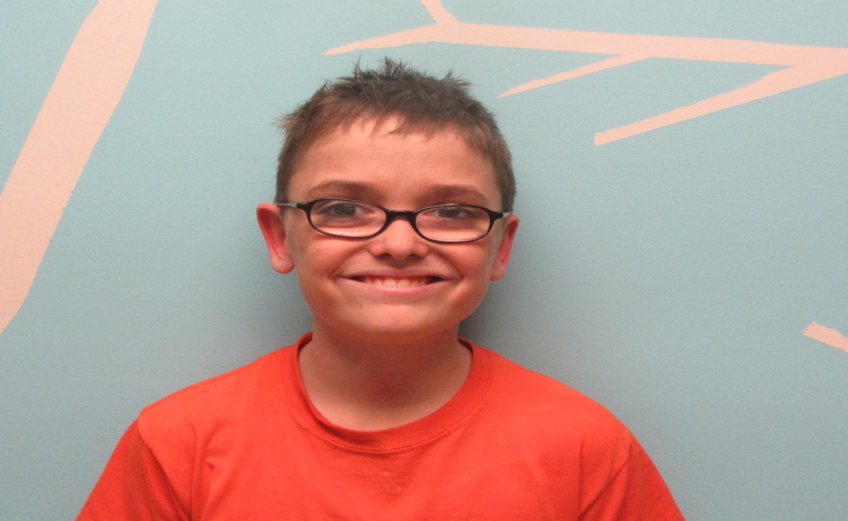
Lucas
I like this because I get to be in Mrs. Vogt’s room and hear different stories. It helps me be a better reader.

Slide 10
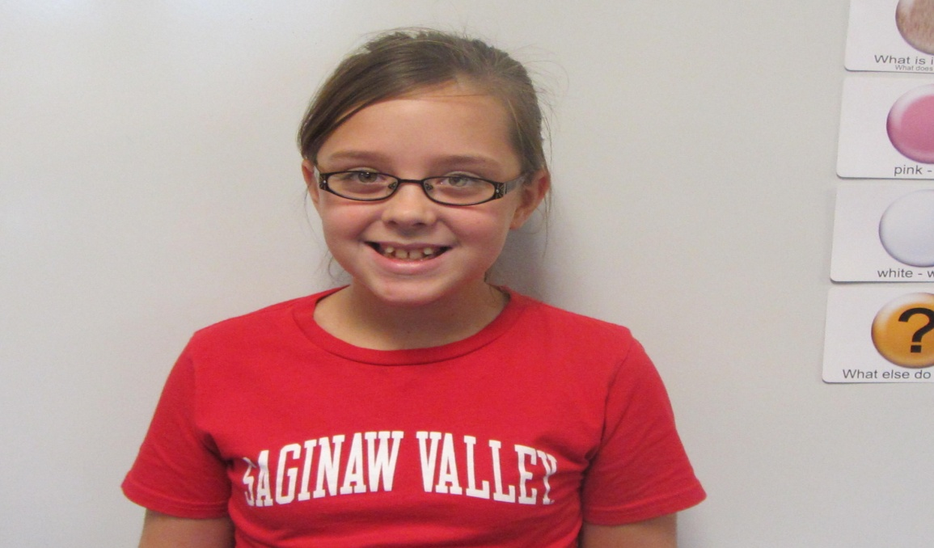
Mackenzie
I like it because I’m learning a lot more because of different groups. I am learning how to comprehend better. I like how there are activities you do together in class.

Slide 11
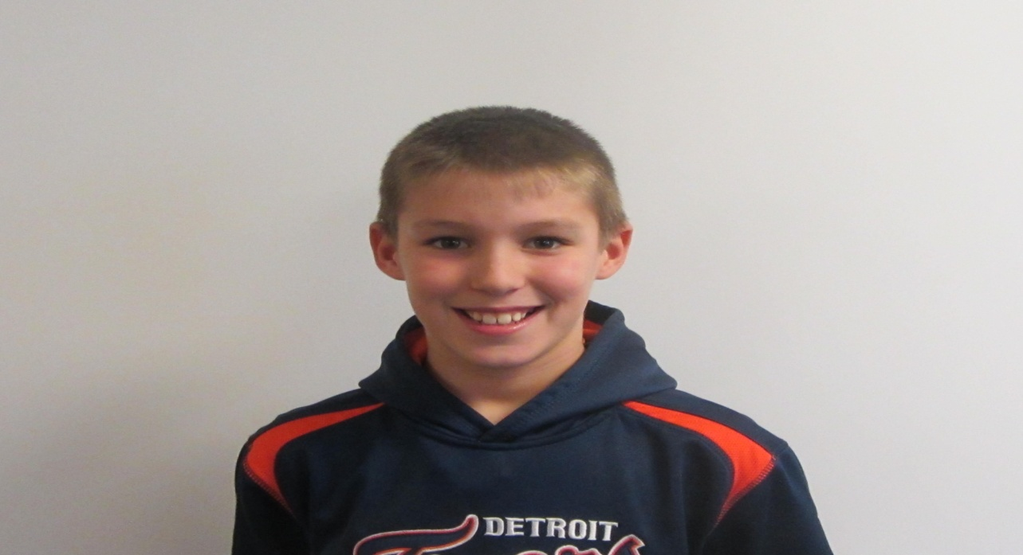
Cam
Mrs. Wilson and Mrs. Vogt give us two different teaching strategies – it helps us understand terms in different ways.

Slide 12
Students have gained a lot of knowledge from this experience.
As teachers, we have benefited tremendously as well.

